Slide 1

Lesson 1.1: POLYGON Lesson 1.2 Triangles Lesson 1.3 Quadrilaterals
Week 1 and Week 2
Math 13
Solid Mensuration
Notes:
Week 5

Slide 2
A polygon is a closed plane figure that is joined by line segments.
A polygon may also be defined as a union of line segments such that: i) each endpoint is the endpoint of only two segments; ii) no two segments intersect except at an endpoint; and iii) no two segments with the same endpoint are collinear.
Reference: Solid Mensuration by Richard Earnhart
Notes:
Week 5

Slide 3
Parts of a Polygon
Side or Edge
Interior Angle
Vertex
Diagonal
Exterior Angle
Reference: Solid Mensuration by Richard Earnhart
Notes:
Week 5

Slide 4
Types of Polygon
Regular Polygon.
In a regular polygon, all angles are equal and all sides are of the same length. Regular polygons are both equiangular and equilateral.
Equiangular Polygon.
A polygon is equiangular if all of its angles are congruent.
Equilateral Polygon.
A polygon is equilateral if all of its sides are equal.
Irregular Polygon.
A polygon that is neither equiangular nor equilateral is said to be an irregular polygon.
Reference: Solid Mensuration by Richard Earnhart
Notes:
Week 5

Slide 5
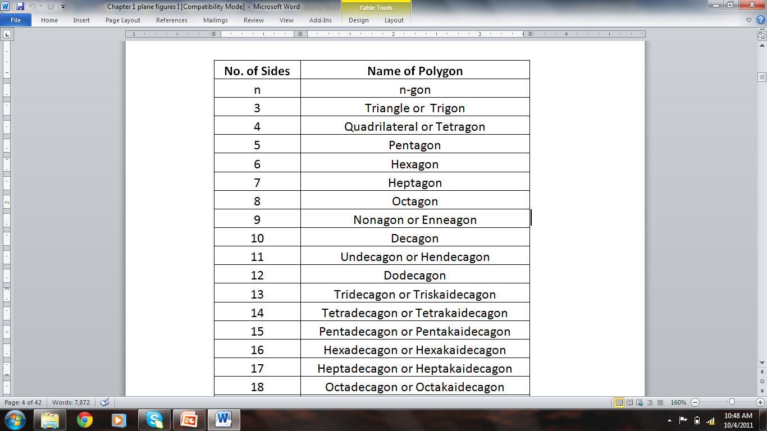
NAMING OF POLYGON
Reference: Solid Mensuration by Richard Earnhart
Notes:
Week 5

Slide 6
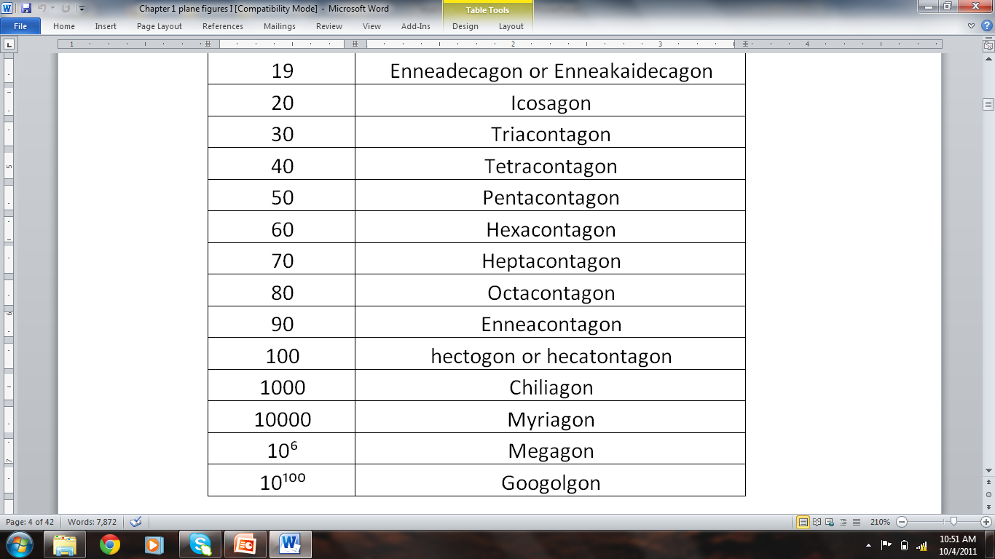
Pythagorean Identities
Negative Arguments Identities
$$\sin^{2} θ+\cos^{2}θ=1$$ | $$\tan^{2}θ+1=\sec^{2}θ$$ | $$1+\cot^{2}θ=\csc^{2}θ$$
$$sin \left(−θ\right)=−sin θ$$ | $$cos \left(−θ\right)=cos θ$$ | $$tan \left(−θ\right)=−tan θ$$
Reference: Solid Mensuration by Richard Earnhart
Notes:
Week 5

Slide 7
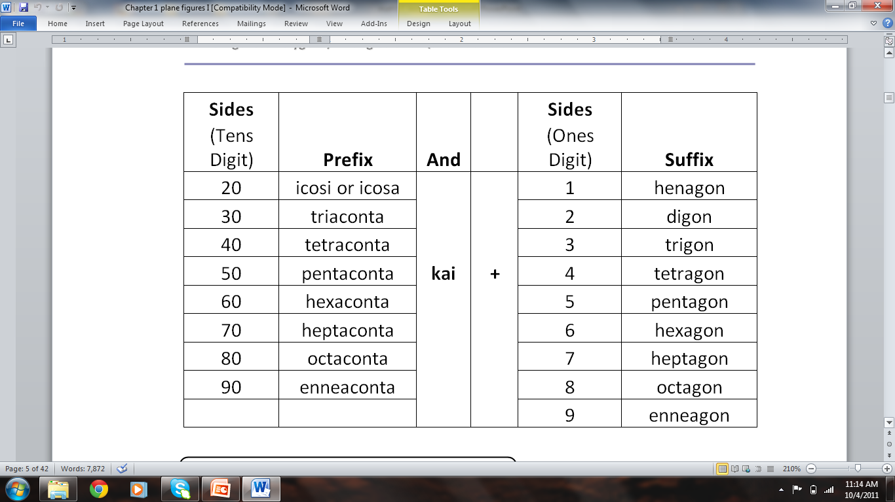
Reference: Solid Mensuration by Richard Earnhart
Notes:
Week 5

Slide 8
For numbers from 100 to 999, we construct the name of the polygon by starting with the prefix for the hundreds digit taken from the ones digit minus the “gon” followed by "hecta," then proceed as before.
Reference: Solid Mensuration by Richard Earnhart
Notes:
Week 5

Slide 9
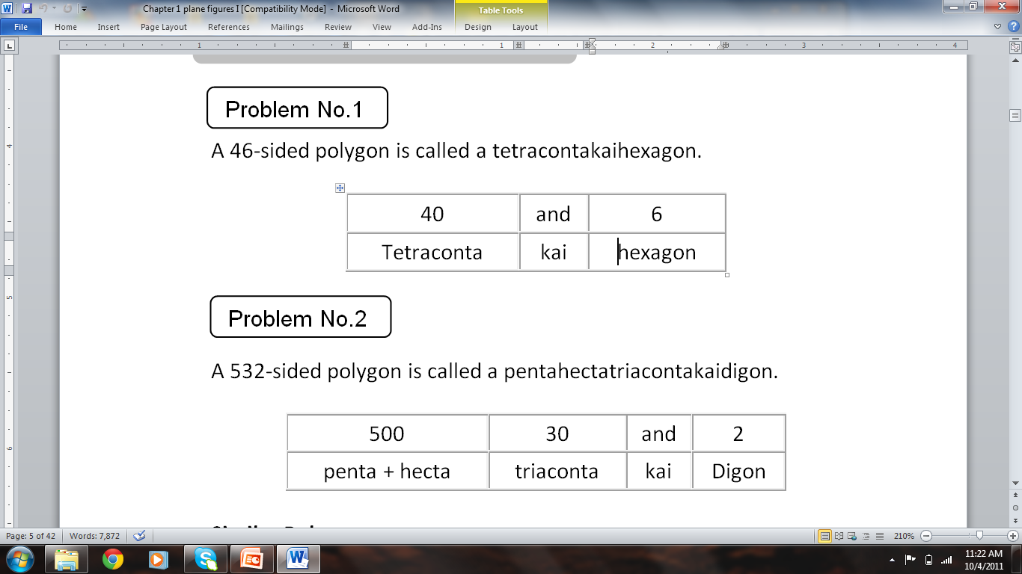
Reference: Solid Mensuration by Richard Earnhart
Notes:
Week 5

Slide 10
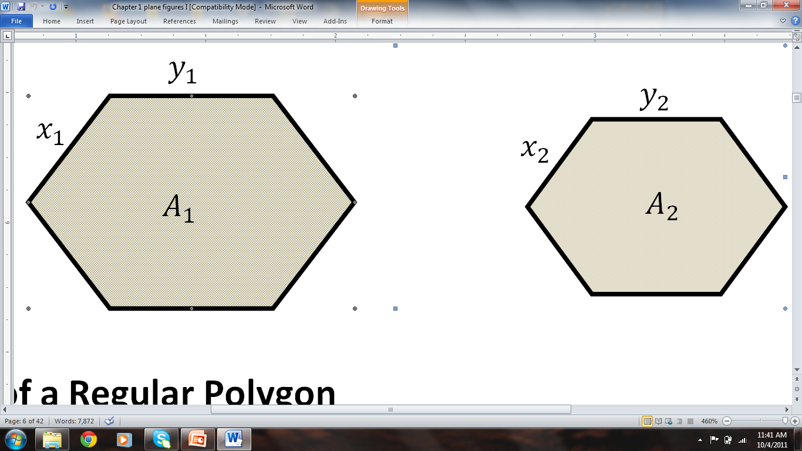
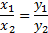
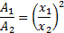
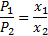
Similar Polygons
By ratio and proportion,
We say that two polygons are similar if their corresponding interior angles are congruent and their corresponding sides are proportional.
Reference: Solid Mensuration by Richard Earnhart
Notes:
Week 5

Slide 11
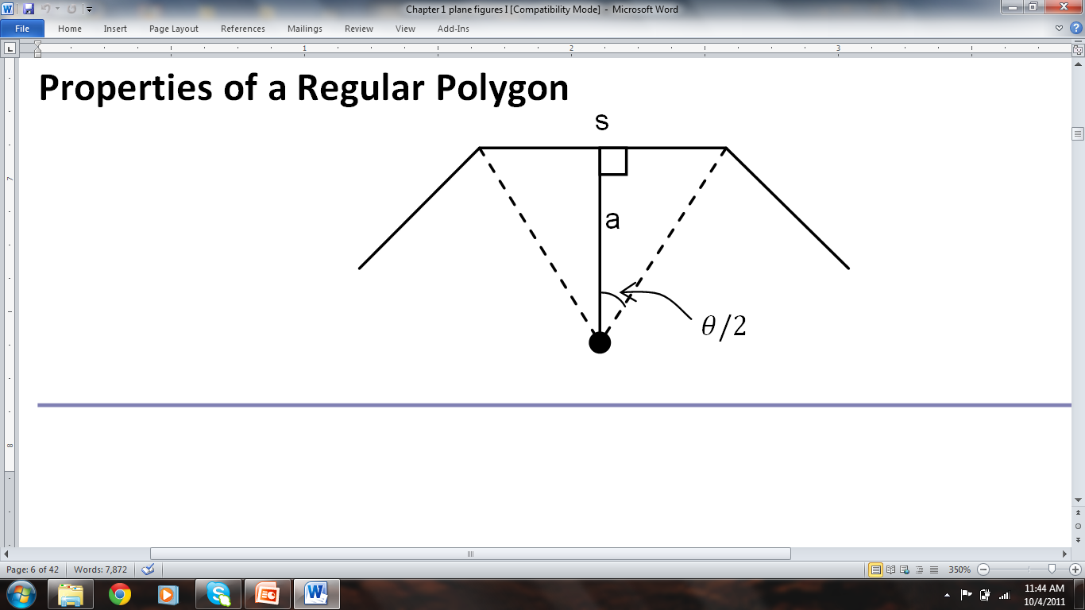
The altitude a of the triangle is called the apothem
The angle that is opposite the base of this triangle
is called the central angle .
Reference: Solid Mensuration by Richard Earnhart
Notes:
Week 5

Slide 12
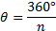
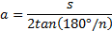
Examples
Perimeter:
Central Angle:
Apothem:
n = no. of sides
s/2
a
θ/2
Reference: Solid Mensuration by Richard Earnhart
Notes:
Week 5

Slide 13
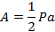
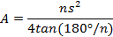
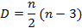
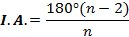
AREA
No. of Diagonals :
Interior Angle:
Sum of Interior Angle:
Reference: Solid Mensuration by Richard Earnhart
Notes:
Week 5

Slide 14
Example 1, page 8
Find the area of a regular nonagon with a side that measures 3 units. Also find the number of diagonals and the sum of its interior angles.
ANS: A= 55.64 s.u., D=27, SIA=1260°
Reference: Solid Mensuration by Richard Earnhart
Notes:
Week 5

Slide 15
EXERCISES 1.1 pp9-11
Find the sum of the interior angle of a regular triacontakaitetragon.
7. Name each polygon with the given number of sides. Also find the corresponding number of diagonals.
a) 24
b) 181
c) 47
d) 653
11. The number of diagonals of a regular polygon is 35. Find the area of the polygon if its apothem measures 10 cm.
12. The number of diagonals of a regular polygon is 65. Find perimeter of the polygon if its apothem measures 8 in.
13. The sum of interior angles of a regular polygon is 1260° . Find the area of the polygon if the perimeter is 45 cm.
Reference: Solid Mensuration by Richard Earnhart
Notes:
Week 5

Slide 16
Homework 1.1
Nos. 15, 17, 19, 21, 23 & 25 pp 11-12
Solid Mensuration by Earnhart

Slide 17
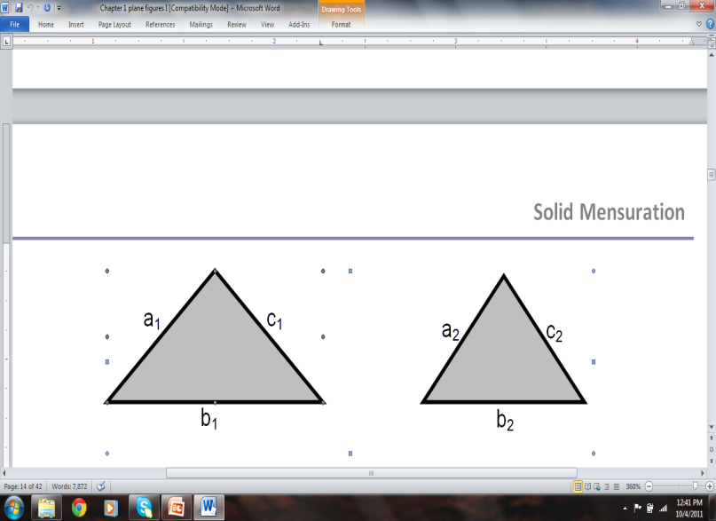
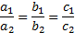
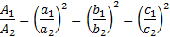
1.2 TRIANGLES
Similar Triangles:
Corresponding angles are congruent and the corresponding sides are proportional.
same shape, different size, different measurement but in proportion.
Reference: Solid Mensuration by Richard Earnhart
Notes:
Week 5

Slide 18
Lines Connected with Triangles
An altitude of a triangle is the line segment drawn from a vertex of the triangle perpendicular to the opposite side.
A median of a triangle is the line segment connecting the midpoint of a side and
the opposite vertex.
An angle bisector of a triangle is the line segment which divides an angle of the triangle into two congruent angles and has endpoints on a vertex and the opposite side.
Reference: Solid Mensuration by Richard Earnhart
Notes:
Week 5

Slide 19
A perpendicular bisector of a side of a triangle is the line segment which meets the side at right angle and divides the side into two congruent segments.
Types of Triangle Centers
Orthocenter is the point of intersection of the triangle’s altitudes.
The centroid is the point of intersection of the three medians of the triangle.
Reference: Solid Mensuration by Richard Earnhart
Notes:
Week 5

Slide 20
The incenter is the point of intersection of the three angle bisectors of the triangle.
The circumcenter is the point of intersection of the perpendicular bisectors of the three sides of the triangle.
Reference: Solid Mensuration by Richard Earnhart

Slide 21
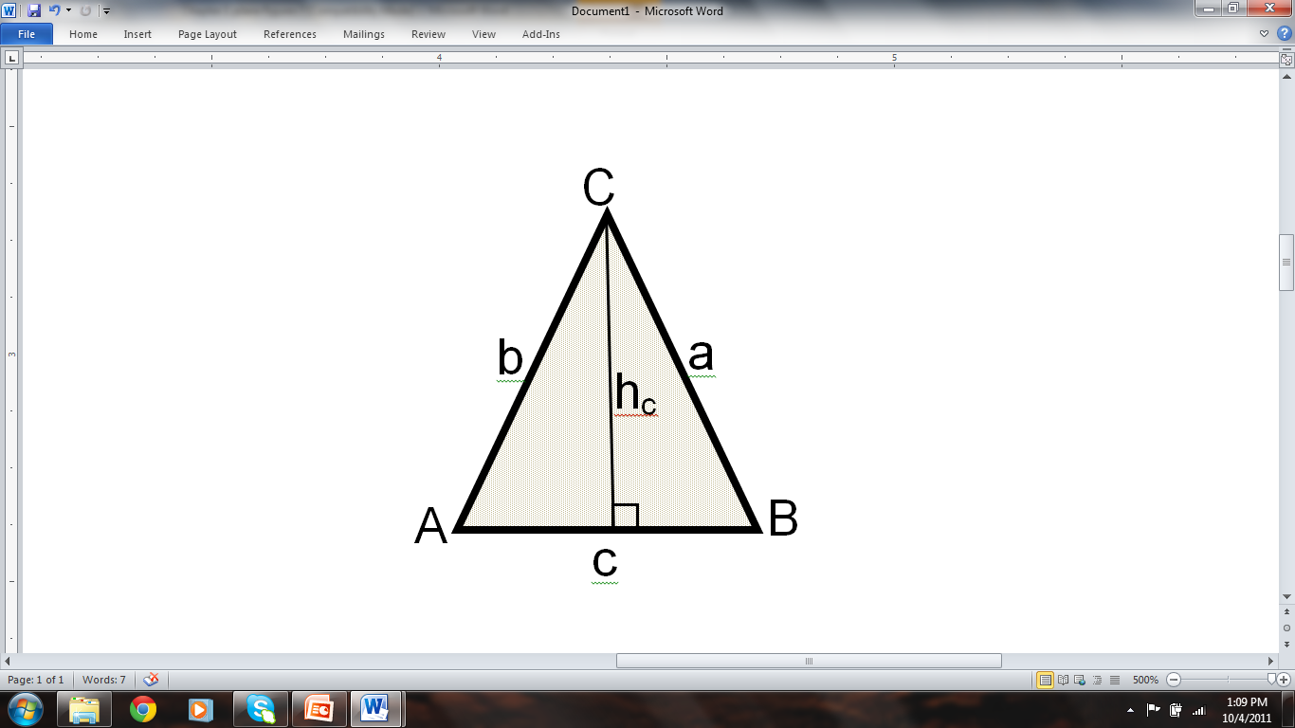
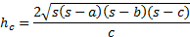
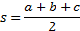
Formulas for the Lengths of Altitude, Median and Angle Bisector of a Triangle
Consider an arbitrary triangle with sides and , and angles and . Let and be the lengths of the altitude, median and bisector originating from vertex .
Reference: Solid Mensuration by Richard Earnhart

Slide 22
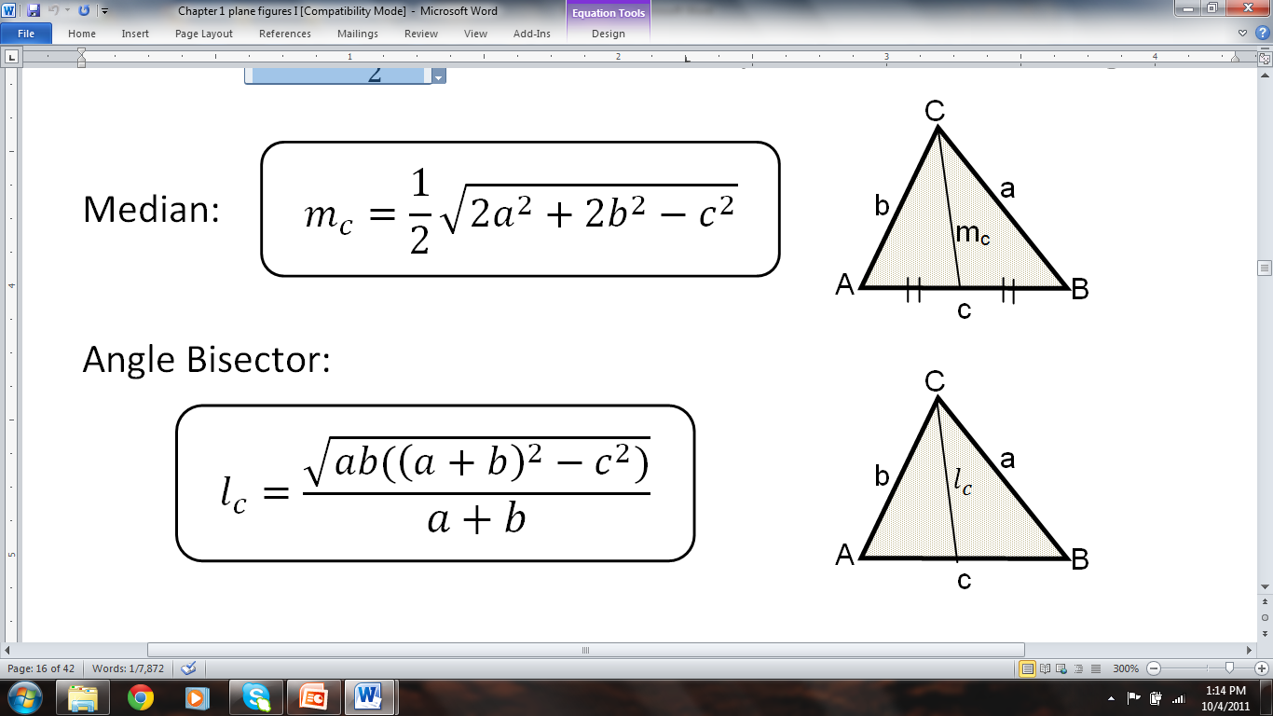
Reference: Solid Mensuration by Richard Earnhart

Slide 23
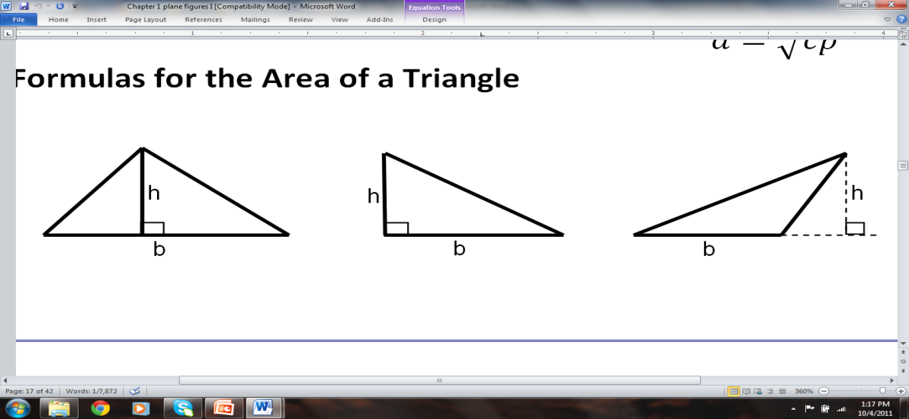
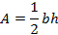
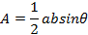
General Formula:
SAS (Side-Angle-Side) Formula:
Heron’s Formula for SSS (Three Sides) Case:
Reference: Solid Mensuration by Richard Earnhart

Slide 24
EXAMPLE 4: Page 17
Given a triangle ABC in which the sides are AB = 30 in., AC = 50 in, and BC = 60 in. On the side AB is a point D through which a line DE is drawn and connected through a point E on side AC so that the angle AED is equal to angle ABC . If the perimeter of the triangle ADE is equal to 56 in , find the sum of the lengths of the line segments BD and CE .
ANS: 48 in
Reference: Solid Mensuration by Richard Earnhart

Slide 25
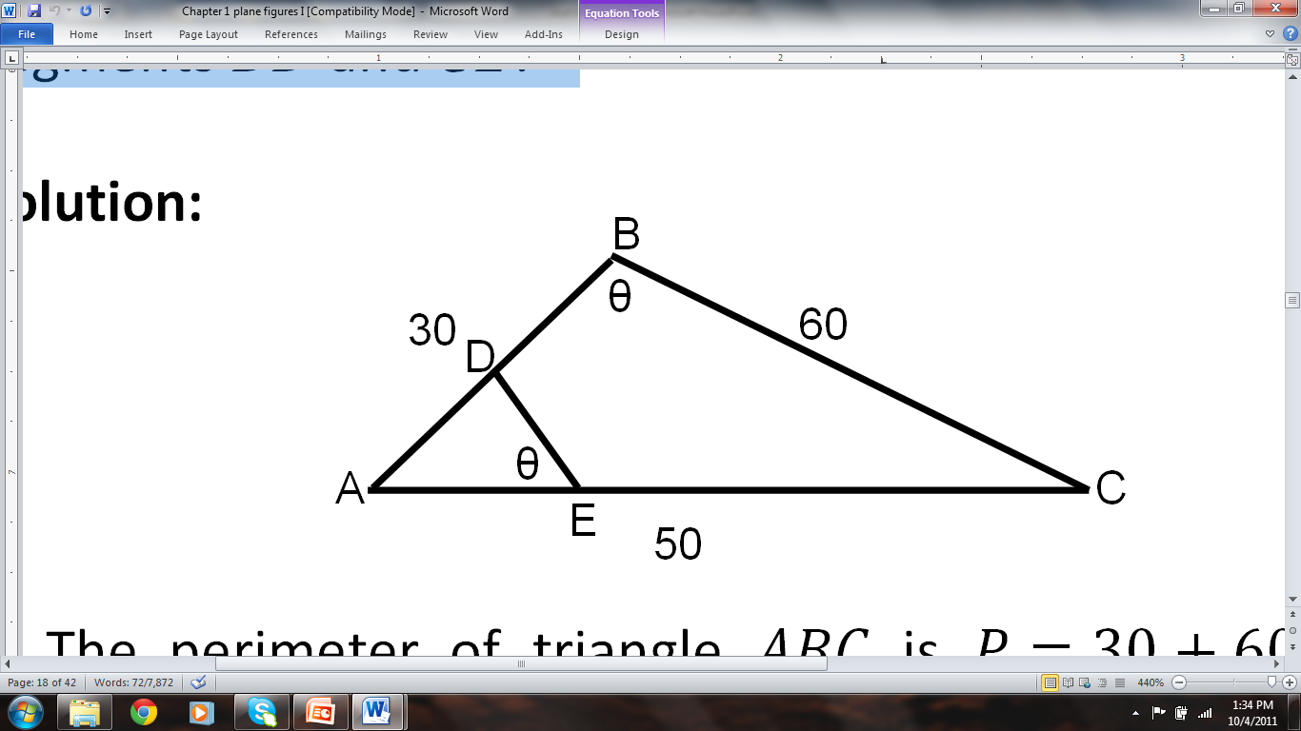
Reference: Solid Mensuration by Richard Earnhart

Slide 26
EXERCISES 1.2
#3, p20: Find the altitude and the area of an equilateral triangle the side of which is 8 cm.
#4, p20: One side of an isosceles triangle is 10 units and the perimeter is 42 units. Find the area of the triangle.
#5, p20: Find the area of an equilateral triangle the altitude of which is 5 cm.
#7,p21: The base of an isosceles triangle and the altitude dropped on one of the congruent sides are equal to 18 cm and 15 cm respectively. Find the sides of the triangle.
Reference: Solid Mensuration by Richard Earnhart

Slide 27
#8,p21: Two altitudes of an isosceles triangle are equal to 20 cm and 30 cm . Determine the base angles of the triangle.
#12,p21: Find the area of a triangle with two sides that measure 6in and 9in , and the bisector of the angle between them is .
#13,p21: In an acute triangle ABC , the altitude AD is drawn. Find the area of triangle ABC if AB=15 in, AC = 18in, and BD=10in .
Reference: Solid Mensuration by Richard Earnhart

Slide 28
Homework 1.2
Nos. 9, 11, 15, 17, 21 pp.21-22
Reference: Solid Mensuration by Richard Earnhart

Slide 29
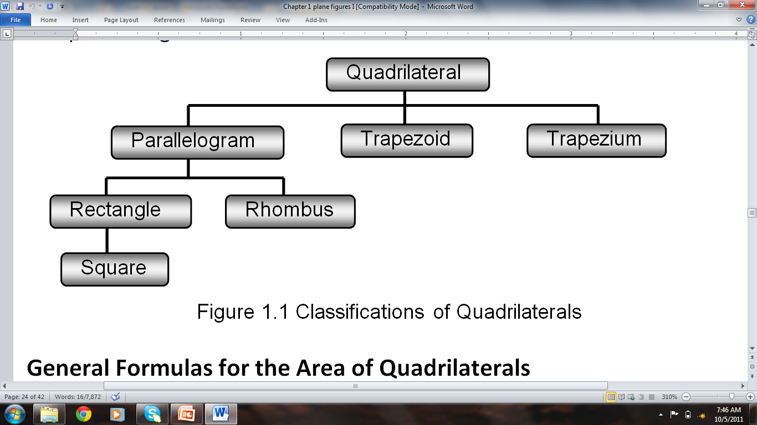
1.3 Quadrilaterals
A quadrilateral, also known as tetragon or quadrangle, is a general term for a four-sided polygon.
Reference: Solid Mensuration by Richard Earnhart

Slide 30
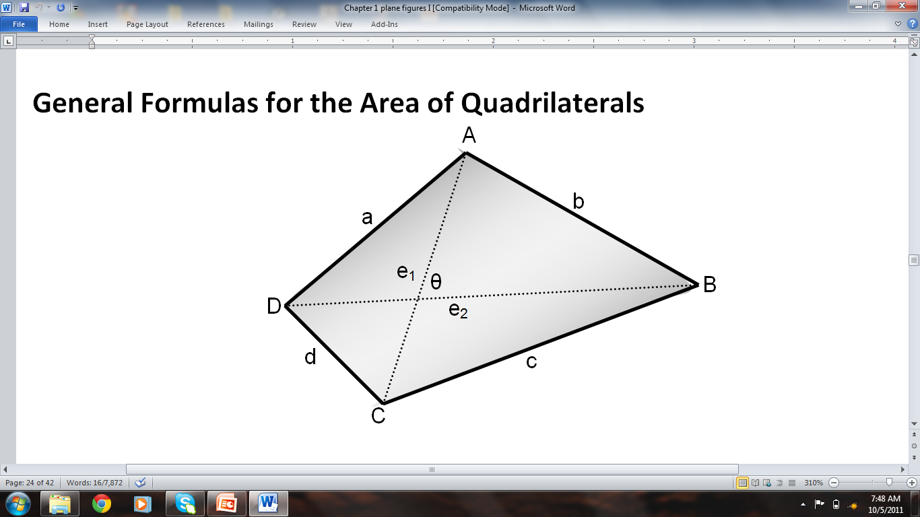
Reference: Solid Mensuration by Richard Earnhart

Slide 31
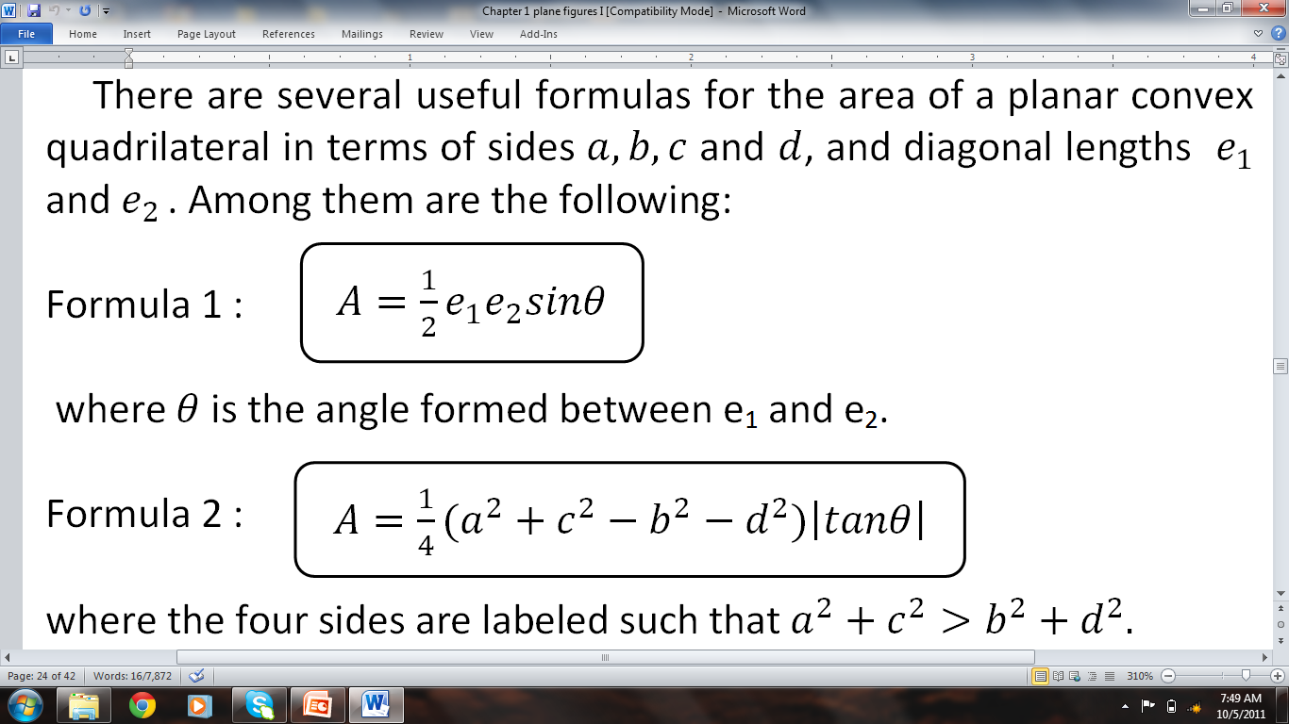
Reference: Solid Mensuration by Richard Earnhart

Slide 32
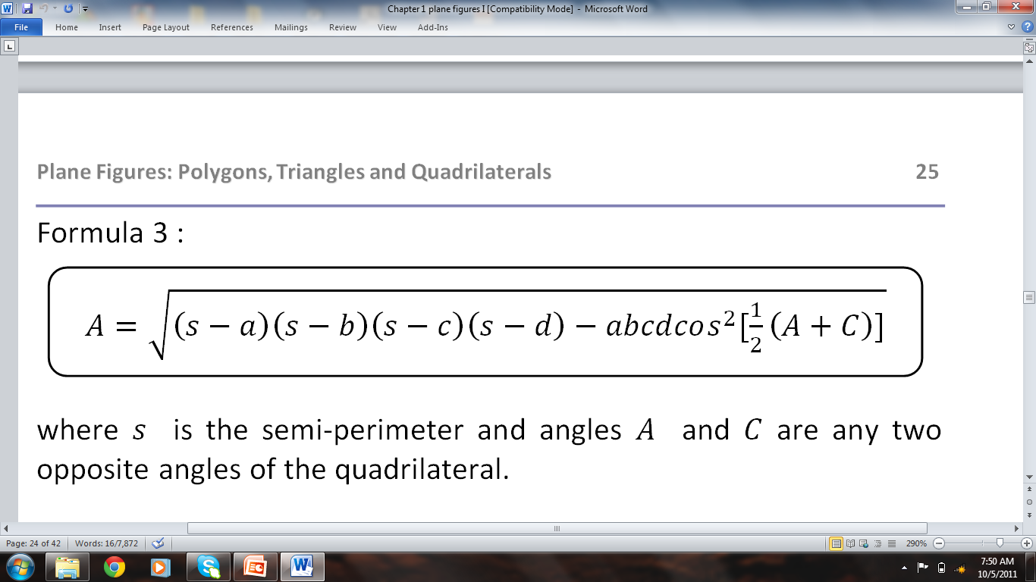
Reference: Solid Mensuration by Richard Earnhart

Slide 33
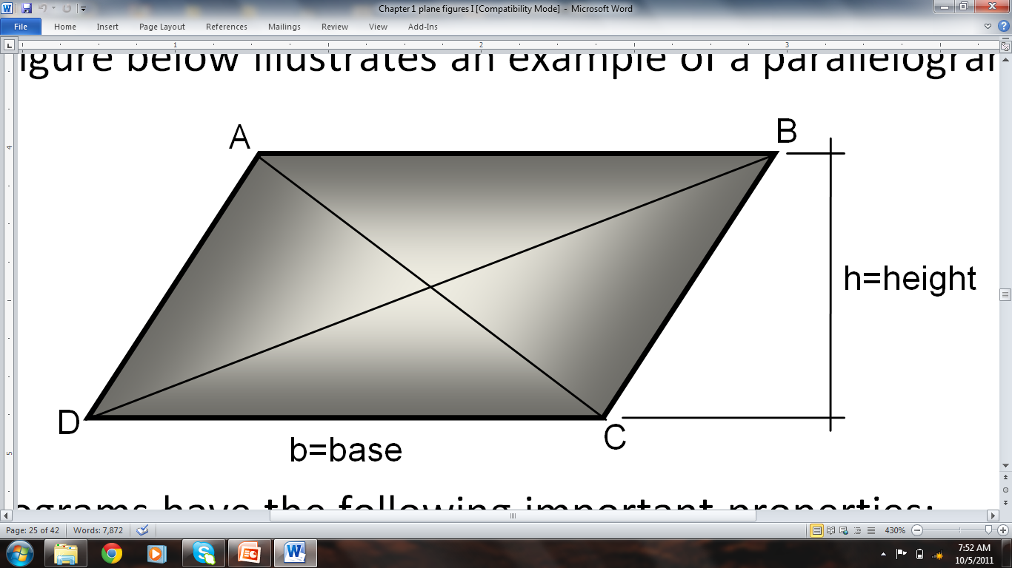
A parallelogram is a quadrilateral in which the opposite sides are parallel.
Reference: Solid Mensuration by Richard Earnhart

Slide 34
Parallelograms have the following important properties:
Opposite sides are equal.
Opposite interior angles are congruent
Adjacent angles are supplementary.
A diagonal divides the parallelogram into two congruent triangles
The two diagonals bisect each other.
Reference: Solid Mensuration by Richard Earnhart

Slide 35
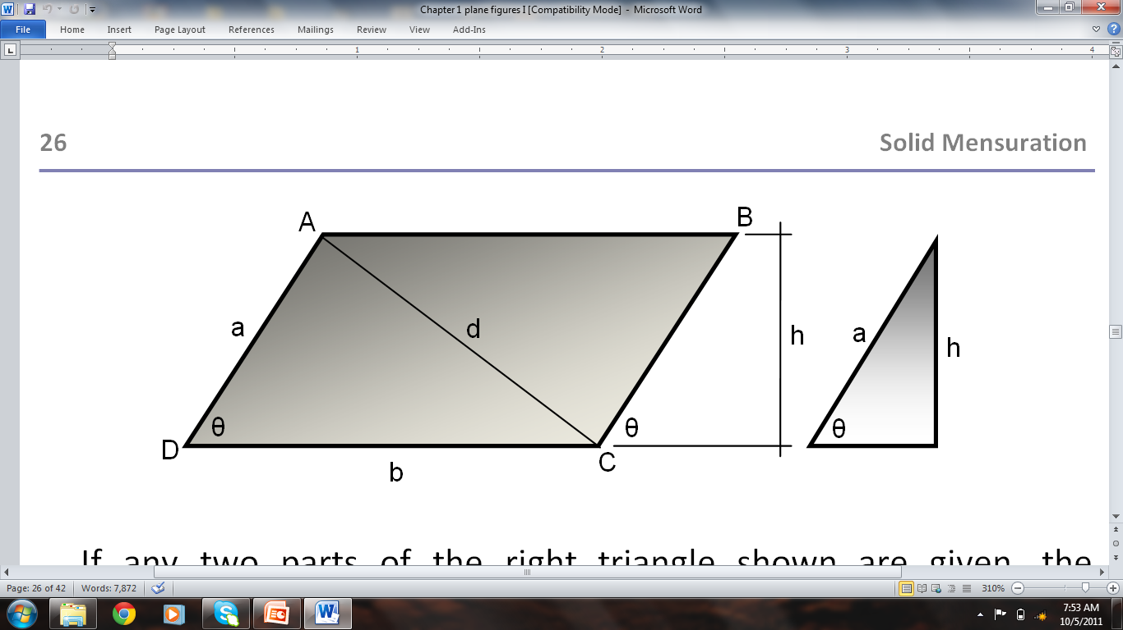
FORMULAS
Reference: Solid Mensuration by Richard Earnhart

Slide 36
AREA OF PARALLELOGRAM
Reference: Solid Mensuration by Richard Earnhart

Slide 37
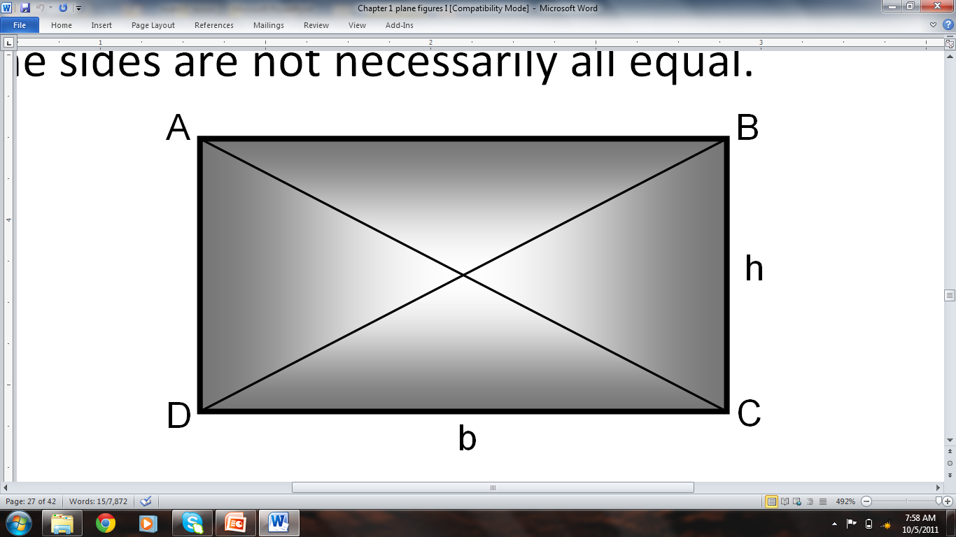
A rectangle is essentially a parallelogram in which the interior angles are all right angles.
Reference: Solid Mensuration by Richard Earnhart

Slide 38
FORMULAS
Reference: Solid Mensuration by Richard Earnhart

Slide 39
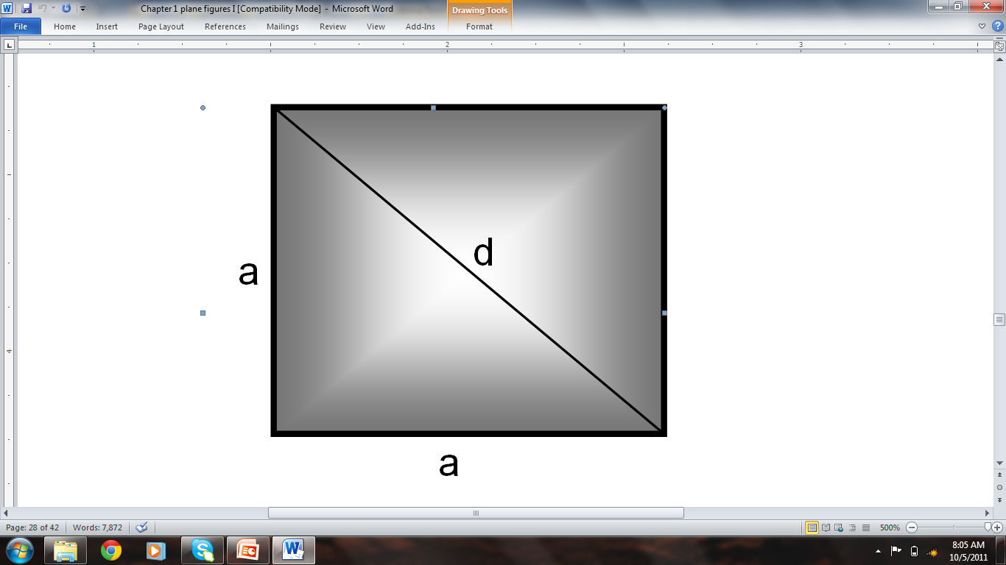
A square is a special type of a rectangle in which all the sides are equal.
Reference: Solid Mensuration by Richard Earnhart

Slide 40
Formulas
Reference: Solid Mensuration by Richard Earnhart

Slide 41
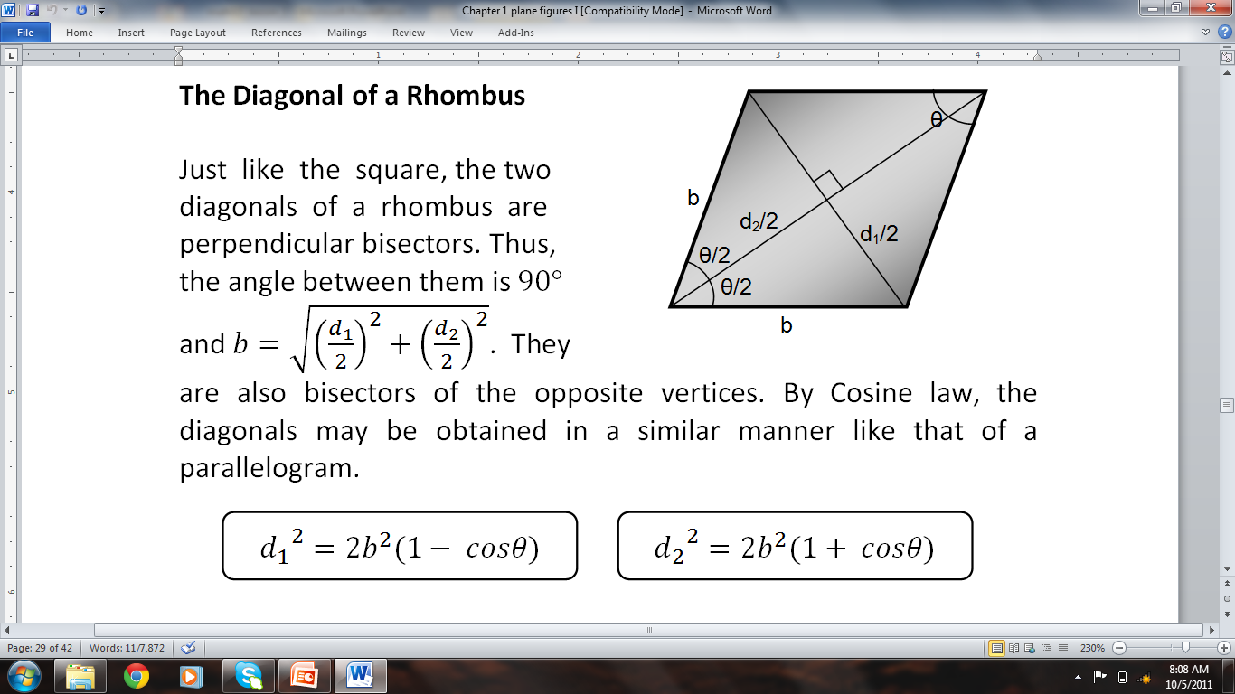
A rhombus is a parallelogram in which all sides are equal.
Reference: Solid Mensuration by Richard Earnhart

Slide 42
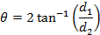
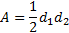
Formulas
Reference: Solid Mensuration by Richard Earnhart

Slide 43
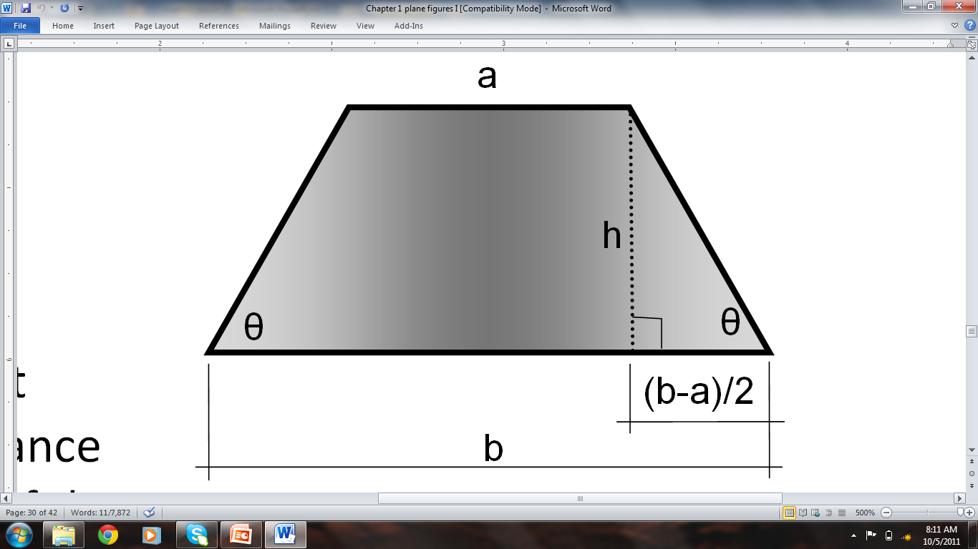
A trapezoid is a quadrilateral with one pair of parallel sides.
If the non-parallel sides are congruent, the trapezoid is called an isosceles trapezoid.
Reference: Solid Mensuration by Richard Earnhart

Slide 44
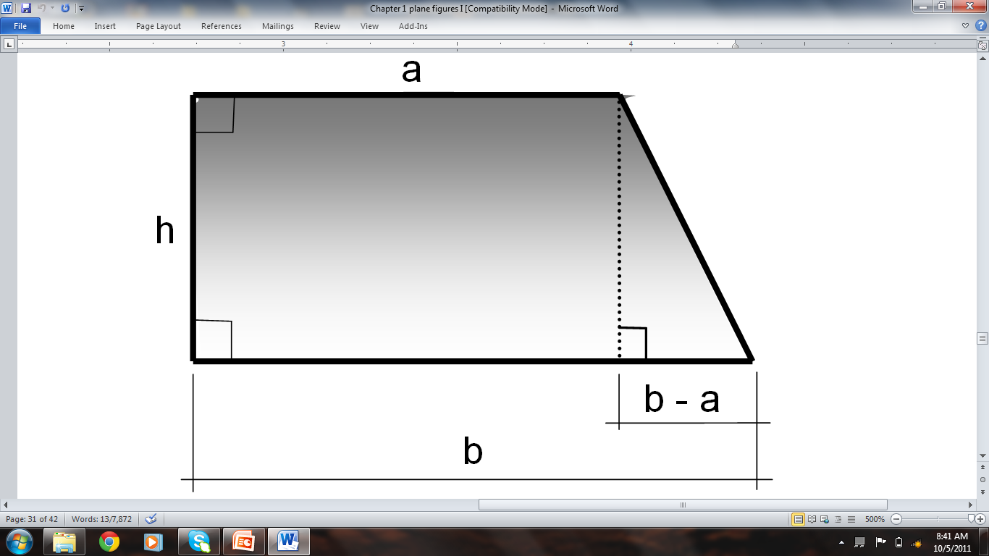
A trapezoid which contains two right angles is called a right trapezoid.
Reference: Solid Mensuration by Richard Earnhart

Slide 45
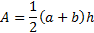
Area of Trapezoid
Reference: Solid Mensuration by Richard Earnhart

Slide 46
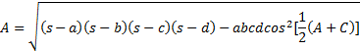
A trapezium is a quadrilateral with no two sides that are parallel.
A and C are any two opposite interior angles
s is the semi-perimeter.
Reference: Solid Mensuration by Richard Earnhart

Slide 47
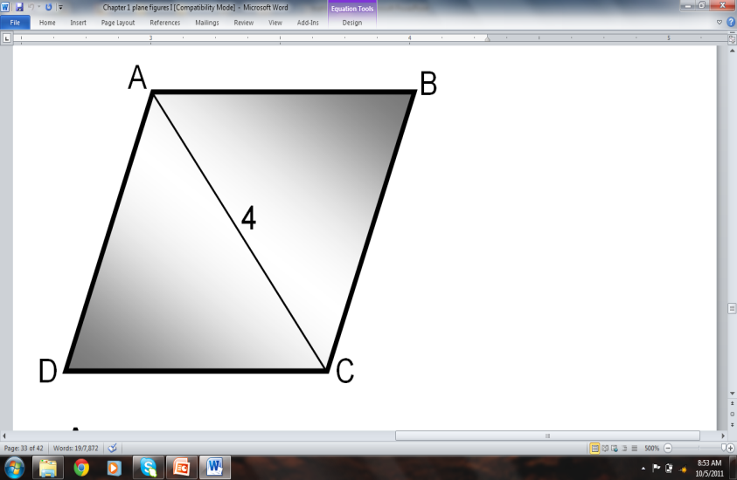
Example 8, p31
The diagonal of a square is 12 units. What is the measure of one side of the square? Find its area and perimeter. ANS. A=72, P=
Example 10, p32
If ABCD is a rhombus, AC=4 , and ADC is an equilateral triangle, what is the area of the rhombus?
ANS: A=13.86

Slide 48
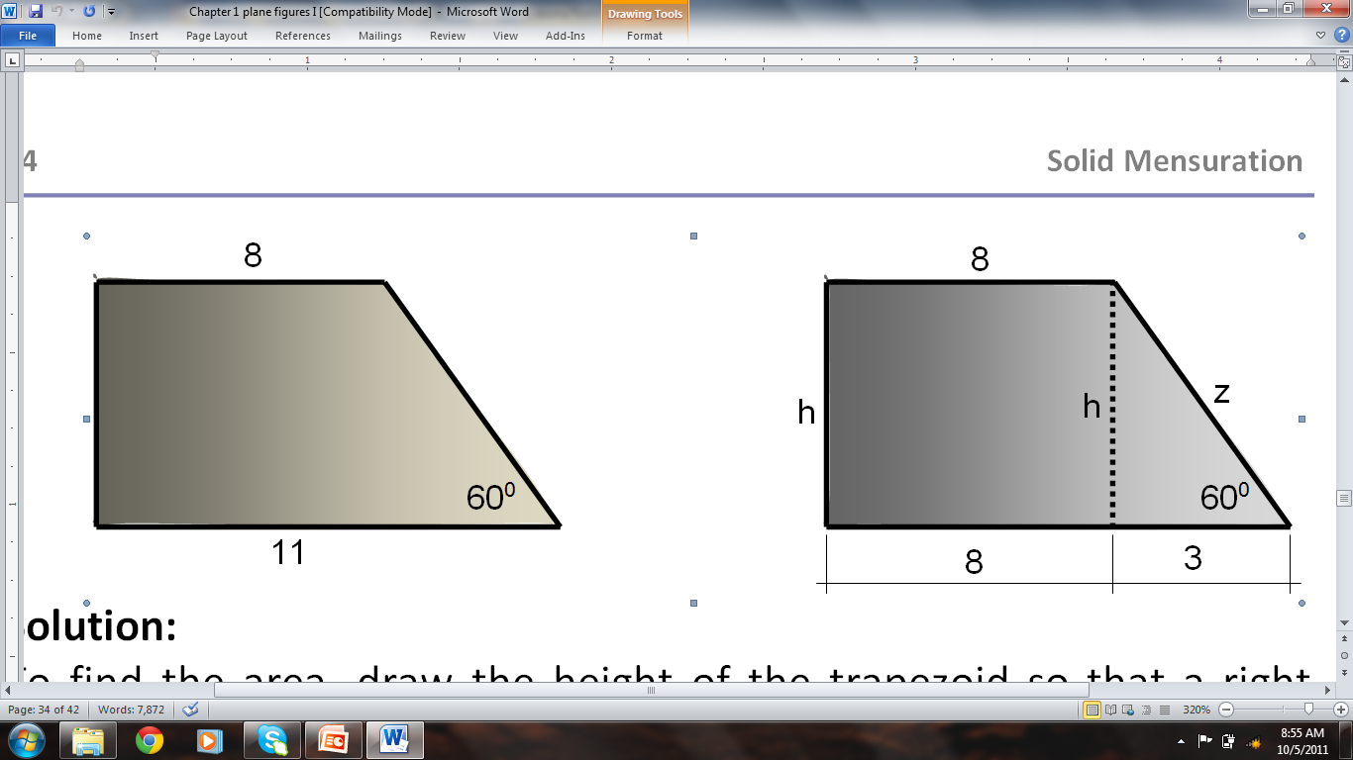
Example 12, p33: Find the area and the perimeter of the right trapezoid shown in the figure. ANS A=49.4, P=30.2
Reference: Solid Mensuration by Richard Earnhart

Slide 49
EXERCISES 1.3
#1, p38: The diagonal of a rectangle is 25 meters long and makes an angle of 36⁰ with one side of the rectangle. Find the area and the perimeter of the rectangle.
#4, p38: A rectangle and a square have the same area. If the length of the side of the square is 6 units and the longest side of the rectangle is 5 more than the measure of the shorter side. Find the dimensions of the rectangle.
Reference: Solid Mensuration by Richard Earnhart

Slide 50
#8, p38: The area of an isosceles trapezoid is 246 m². If the height and the length of one of its congruent sides measure 6m and 10m respectively, find the two bases.
#10, p39: A piece of wire of length 52 m is cut into two parts. Each part is then bent to form a square. It is found that the combined area of the two squares is 109 m². Find the sides of the two squares.
Reference: Solid Mensuration by Richard Earnhart

Slide 51
#11, p39: A rhombus has diagonals of 32 and 20 inches. Find the area and the angle opposite the longer diagonal.
# 26, p40: Find the area of a rhombus in which one side measures 10cm and one of the diagonals measures 12cm .
Reference: Solid Mensuration by Richard Earnhart

Slide 52
Homework 1.3
Nos. 7, 9, 15, 20, 23, 25, 28 & 29 pp.38-40.
Reference: Solid Mensuration by Richard Earnhart

Slide 53
Reference: Solid Mensuration by Richard Earnhart

Slide 54
Reference: Solid Mensuration by Richard Earnhart

